Slide 1
Chapter 3 outline
3.1 Transport-layer services
3.2 Multiplexing and demultiplexing
3.3 Connectionless transport: UDP
3.4 Principles of reliable data transfer
3.5 Connection-oriented transport: TCP
segment structure
reliable data transfer
flow control
connection management
3.6 Principles of congestion control
3.7 TCP congestion control
Transport Layer
3-1

Slide 2







Transport services and protocols
application
transport
network
data link
physical
provide logical communication between app processes running on different hosts
transport protocols run in end systems
send side: breaks app messages into segments, passes to network layer
rcv side: reassembles segments into messages, passes to app layer
more than one transport protocol available to apps
Internet: TCP and UDP
logical end-end transport
application
transport
network
data link
physical
Transport Layer
3-2

Slide 3
Transport vs. network layer
network layer: logical communication between hosts
transport layer: logical communication between processes
relies on, enhances, network layer services
Household analogy:
12 kids sending letters to 12 kids
processes = kids
app messages = letters in envelopes
hosts = houses
transport protocol = Ann and Bill
network-layer protocol = postal service
Transport Layer
3-3

Slide 4
Internet transport-layer protocols
reliable, in-order delivery (TCP)
congestion control
flow control
connection setup
unreliable, unordered delivery: UDP
no-frills extension of “best-effort” IP
services not available:
delay guarantees
bandwidth guarantees
application
transport
network
data link
physical
network
data link
physical
network
data link
physical
logical end-end transport
network
data link
physical
network
data link
physical
network
data link
physical
network
data link
physical
application
transport
network
data link
physical
Transport Layer
3-4

Slide 5
Chapter 3 outline
3.1 Transport-layer services
3.2 Multiplexing and demultiplexing
3.3 Connectionless transport: UDP
3.4 Principles of reliable data transfer
3.5 Connection-oriented transport: TCP
segment structure
reliable data transfer
flow control
connection management
3.6 Principles of congestion control
3.7 TCP congestion control
Transport Layer
3-5

Slide 6
Multiplexing/demultiplexing
Demultiplexing at rcv host:
Multiplexing at send host:
delivering received segments
to correct socket
gathering data from multiple
sockets, enveloping data with
header (later used for
demultiplexing)
= socket
= process
application
application
application
P4
P3
P1
P2
P1
transport
transport
transport
network
network
network
link
link
link
physical
physical
physical
host 1
host 2
host 3
Transport Layer
3-6

Slide 7
How demultiplexing works
host receives IP datagrams
each datagram has source IP address, destination IP address
each datagram carries 1 transport-layer segment
each segment has source, destination port number
host uses IP addresses & port numbers to direct segment to appropriate socket
32 bits
source port #
dest port #
other header fields
application
data
(message)
TCP/UDP segment format
Transport Layer
3-7

Slide 8
Connectionless demultiplexing
When host receives UDP segment:
checks destination port number in segment
directs UDP segment to socket with that port number
IP datagrams with different source IP addresses and/or source port numbers directed to same socket
Create sockets with port numbers:
DatagramSocket mySocket1 = new DatagramSocket(12534);
DatagramSocket mySocket2 = new DatagramSocket(12535);
UDP socket identified by two-tuple:
(dest IP address, dest port number)
Transport Layer
3-8

Slide 9
Connectionless demux (cont)
DatagramSocket serverSocket = new DatagramSocket(6428);
P2
P1
P3
P1
SP: 6428
SP: 6428
DP: 9157
DP: 5775
SP: 9157
SP: 5775
client
IP: A
DP: 6428
server
IP: C
DP: 6428
Client
IP:B
SP provides “return address”
Transport Layer
3-9

Slide 10
Connection-oriented demux
TCP socket identified by 4-tuple:
source IP address
source port number
dest IP address
dest port number
receiving host uses all four values to direct segment to appropriate socket
Server host may support many simultaneous TCP sockets:
each socket identified by its own 4-tuple
Web servers have different sockets for each connecting client
non-persistent HTTP will have different socket for each request
Transport Layer
3-10

Slide 11
Connection-oriented demux (cont)
P1
P4
P5
P6
P2
P1
P3
SP: 5775
DP: 80
S-IP: B
D-IP:C
SP: 9157
SP: 9157
client
IP: A
DP: 80
server
IP: C
DP: 80
Client
IP:B
S-IP: A
S-IP: B
D-IP:C
D-IP:C
Transport Layer
3-11

Slide 12
Connection-oriented demux: Threaded Web Server
P1
P4
P2
P1
P3
SP: 5775
DP: 80
S-IP: B
D-IP:C
SP: 9157
SP: 9157
client
IP: A
DP: 80
server
IP: C
DP: 80
Client
IP:B
S-IP: A
S-IP: B
D-IP:C
D-IP:C
Transport Layer
3-12

Slide 13
Chapter 3 outline
3.1 Transport-layer services
3.2 Multiplexing and demultiplexing
3.3 Connectionless transport: UDP
3.4 Principles of reliable data transfer
3.5 Connection-oriented transport: TCP
segment structure
reliable data transfer
flow control
connection management
3.6 Principles of congestion control
3.7 TCP congestion control
Transport Layer
3-13

Slide 14
UDP: User Datagram Protocol [RFC 768]
“no frills,” “bare bones” Internet transport protocol
“best effort” service, UDP segments may be:
lost
delivered out of order to app
connectionless:
no handshaking between UDP sender, receiver
each UDP segment handled independently of others
Why is there a UDP?
no connection establishment (which can add delay)
simple: no connection state at sender, receiver
small segment header
no congestion control: UDP can blast away as fast as desired
Transport Layer
3-14

Slide 15
UDP: more
often used for streaming multimedia apps
loss tolerant
rate sensitive
other UDP uses
DNS
SNMP
reliable transfer over UDP: add reliability at application layer
application-specific error recovery!
32 bits
Length, in
bytes of UDP
segment,
including
header
source port #
dest port #
length
checksum
Application
data
(message)
UDP segment format
Transport Layer
3-15

Slide 16
Chapter 3 outline
3.1 Transport-layer services
3.2 Multiplexing and demultiplexing
3.3 Connectionless transport: UDP
3.4 Principles of reliable data transfer
3.5 Connection-oriented transport: TCP
segment structure
reliable data transfer
flow control
connection management
3.6 Principles of congestion control
3.7 TCP congestion control
Transport Layer
3-16

Slide 17
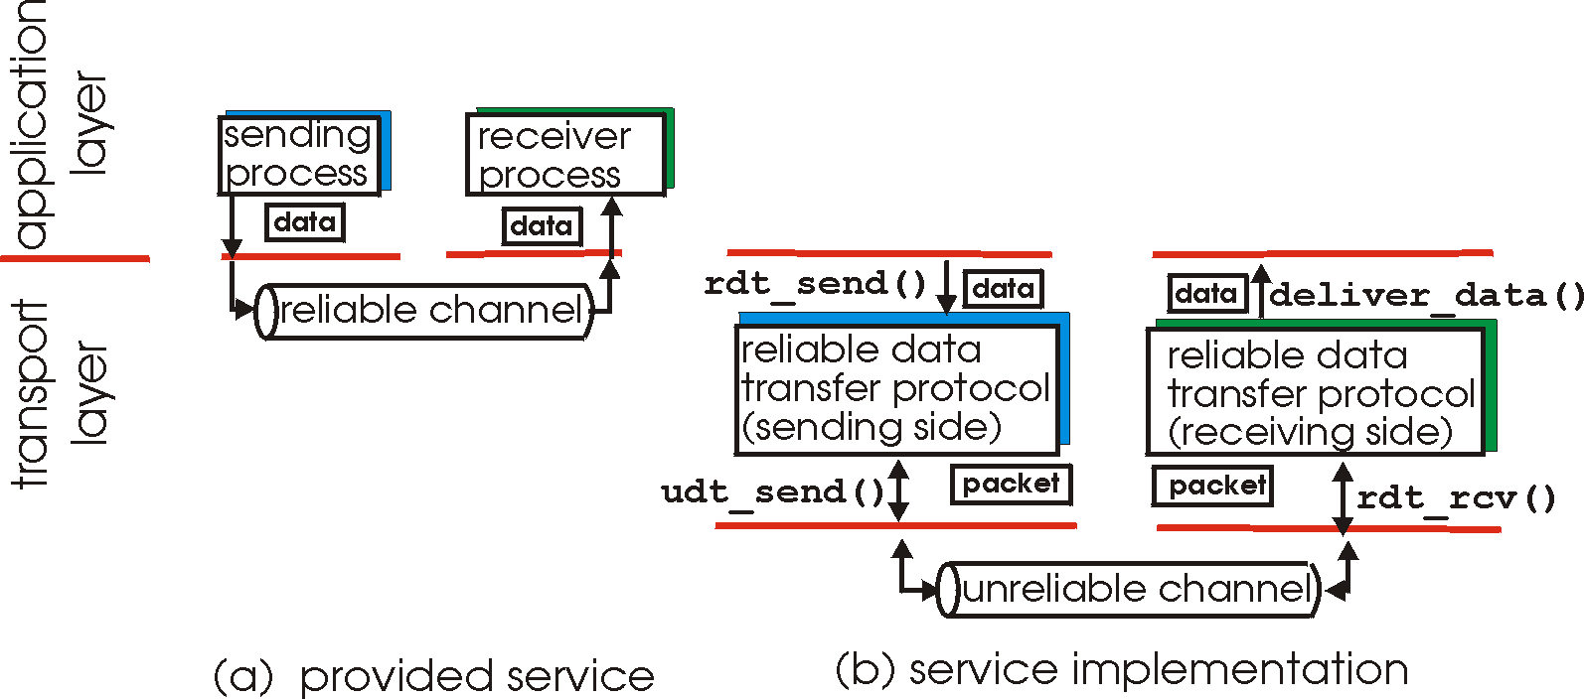
Principles of Reliable data transfer
important in app., transport, link layers
top-10 list of important networking topics!
characteristics of unreliable channel will determine complexity of reliable data transfer protocol (rdt)
Transport Layer
3-17

Slide 18
Principles of Reliable data transfer
important in app., transport, link layers
top-10 list of important networking topics!
characteristics of unreliable channel will determine complexity of reliable data transfer protocol (rdt)
Transport Layer
3-18

Slide 19
Principles of Reliable data transfer
important in app., transport, link layers
top-10 list of important networking topics!
characteristics of unreliable channel will determine complexity of reliable data transfer protocol (rdt)
Transport Layer
3-19

Slide 20
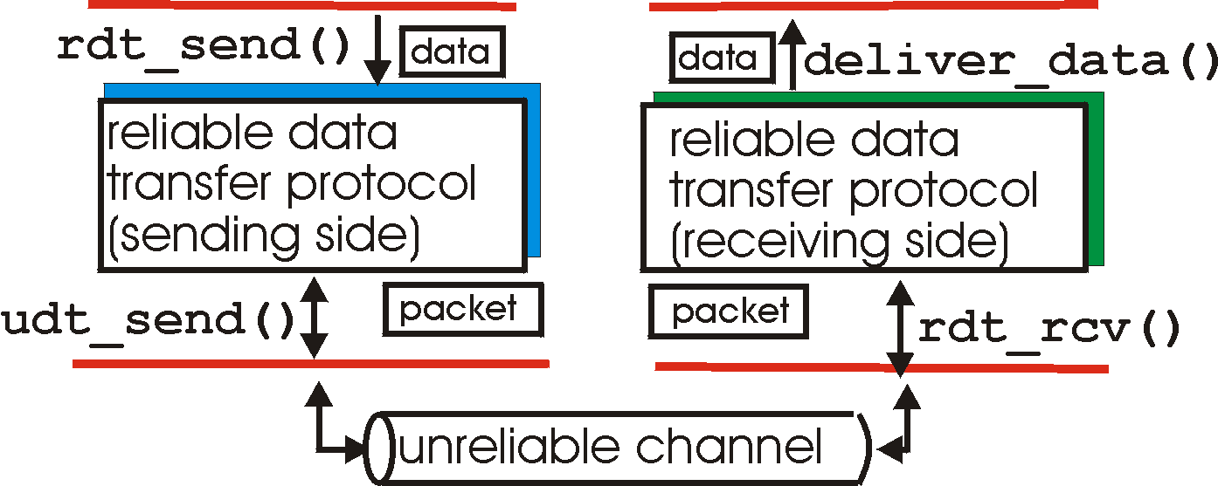
Reliable data transfer: getting started
rdt_send(): called from above, (e.g., by app.). Passed data to
deliver to receiver upper layer
deliver_data(): called by rdt to deliver data to upper
send
side
receive
side
udt_send(): called by rdt,
to transfer packet over
unreliable channel to receiver
rdt_rcv(): called when packet arrives on rcv-side of channel
Transport Layer
3-20

Slide 21
Reliable data transfer: getting started
We’ll:
incrementally develop sender, receiver sides of reliable data transfer protocol (rdt)
consider only unidirectional data transfer
but control info will flow on both directions!
use finite state machines (FSM) to specify sender, receiver
event causing state transition
state: when in this “state” next state uniquely determined by next event
actions taken on state transition
state
1
state
2
event
actions
Transport Layer
3-21

Slide 22
Rdt1.0: reliable transfer over a reliable channel
underlying channel perfectly reliable
no bit errors
no loss of packets
separate FSMs for sender, receiver:
sender sends data into underlying channel
receiver read data from underlying channel
Wait for call from above
rdt_send(data)
Wait for call from below
rdt_rcv(packet)
extract (packet,data)
deliver_data(data)
packet = make_pkt(data)
udt_send(packet)
sender
receiver
Transport Layer
3-22

Slide 23
Rdt2.0: channel with bit errors
underlying channel may flip bits in packet
checksum to detect bit errors
the question: how to recover from errors:
acknowledgements (ACKs): receiver explicitly tells sender that pkt received OK
negative acknowledgements (NAKs): receiver explicitly tells sender that pkt had errors
sender retransmits pkt on receipt of NAK
new mechanisms in rdt2.0 (beyond rdt1.0):
error detection
receiver feedback: control msgs (ACK,NAK) rcvr->sender
Transport Layer
3-23

Slide 24
rdt2.0: FSM specification
rdt_send(data)
snkpkt = make_pkt(data, checksum)
udt_send(sndpkt)
receiver
rdt_rcv(rcvpkt) &&
isNAK(rcvpkt)
Wait for call from above
Wait for ACK or NAK
rdt_rcv(rcvpkt) &&
corrupt(rcvpkt)
udt_send(sndpkt)
udt_send(NAK)
rdt_rcv(rcvpkt) && isACK(rcvpkt)
Λ
Wait for call from below
sender
rdt_rcv(rcvpkt) &&
notcorrupt(rcvpkt)
extract(rcvpkt,data)
deliver_data(data)
udt_send(ACK)
Transport Layer
3-24

Slide 25
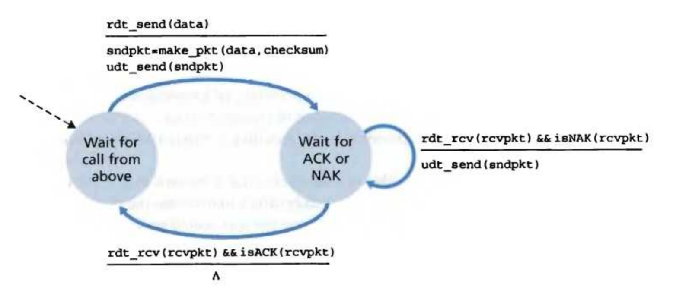
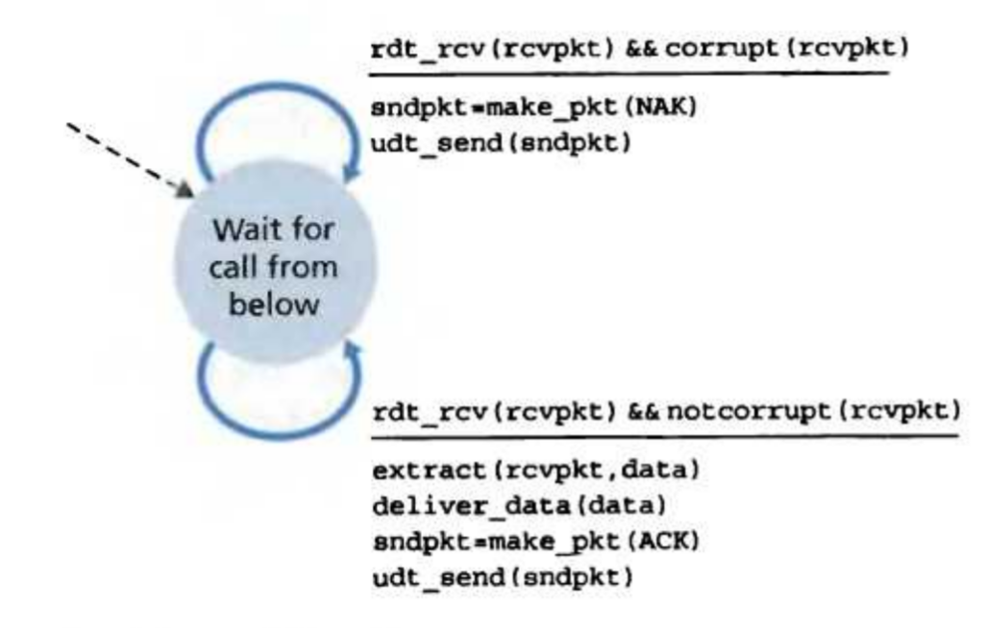
rdt2.0: FSM specification
Transport Layer
3-25

Slide 26
rdt2.0: operation with no errors
rdt_send(data)
snkpkt = make_pkt(data, checksum)
udt_send(sndpkt)
rdt_rcv(rcvpkt) &&
isNAK(rcvpkt)
Wait for call from above
Wait for ACK or NAK
rdt_rcv(rcvpkt) &&
corrupt(rcvpkt)
udt_send(sndpkt)
udt_send(NAK)
rdt_rcv(rcvpkt) && isACK(rcvpkt)
Wait for call from below
Λ
rdt_rcv(rcvpkt) &&
notcorrupt(rcvpkt)
extract(rcvpkt,data)
deliver_data(data)
udt_send(ACK)
Transport Layer
3-26

Slide 27
rdt2.0: error scenario
rdt_send(data)
snkpkt = make_pkt(data, checksum)
udt_send(sndpkt)
rdt_rcv(rcvpkt) &&
isNAK(rcvpkt)
Wait for call from above
Wait for ACK or NAK
rdt_rcv(rcvpkt) &&
corrupt(rcvpkt)
udt_send(sndpkt)
udt_send(NAK)
rdt_rcv(rcvpkt) && isACK(rcvpkt)
Wait for call from below
Λ
rdt_rcv(rcvpkt) &&
notcorrupt(rcvpkt)
extract(rcvpkt,data)
deliver_data(data)
udt_send(ACK)
Transport Layer
3-27

Slide 28
rdt2.0 has a fatal flaw!
What happens if ACK/NAK corrupted?
sender doesn’t know what happened at receiver!
can’t just retransmit: possible duplicate
Handling duplicates:
sender retransmits current pkt if ACK/NAK garbled
sender adds sequence number to each pkt
receiver discards (doesn’t deliver up) duplicate pkt
stop and wait
Sender sends one packet,
then waits for receiver
response
Transport Layer
3-28

Slide 29
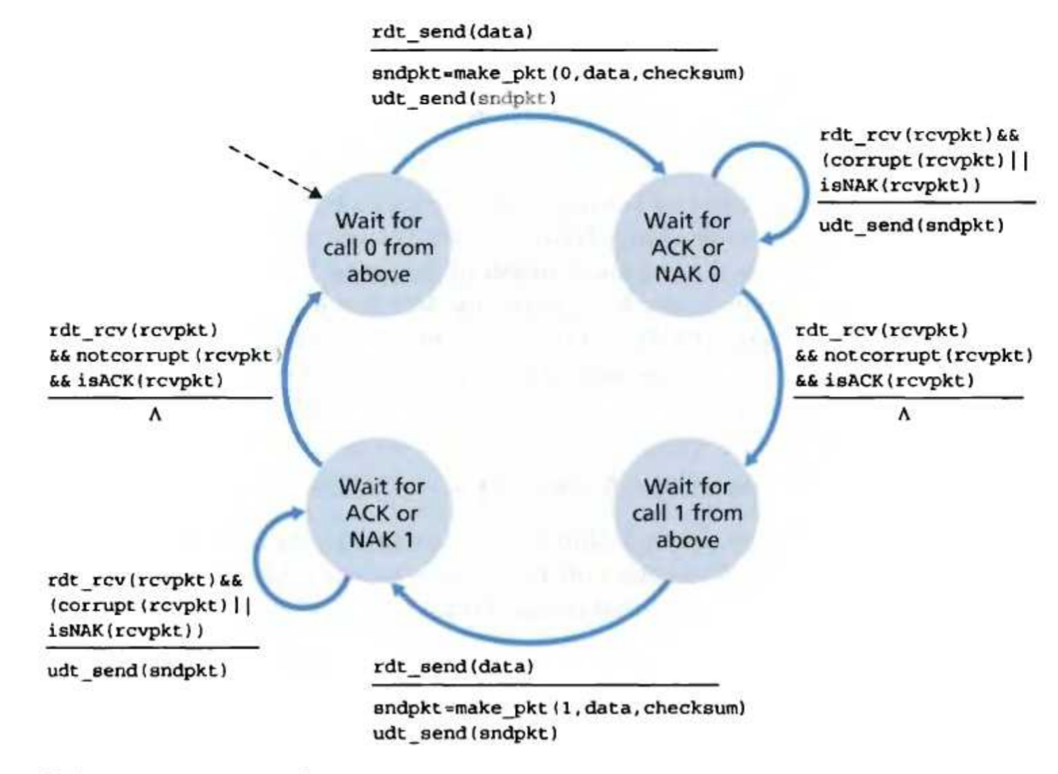
rdt2.1: sender, handles garbled ACK/NAKs
rdt_send(data)
sndpkt = make_pkt(0, data, checksum)
udt_send(sndpkt)
rdt_rcv(rcvpkt) &&
( corrupt(rcvpkt) ||
isNAK(rcvpkt) )
Wait for call 0 from above
Wait for ACK or NAK 0
udt_send(sndpkt)
rdt_rcv(rcvpkt)
&& notcorrupt(rcvpkt)
&& isACK(rcvpkt)
rdt_rcv(rcvpkt)
&& notcorrupt(rcvpkt)
&& isACK(rcvpkt)
Λ
Λ
Wait for ACK or NAK 1
Wait for
call 1 from above
rdt_rcv(rcvpkt) &&
( corrupt(rcvpkt) ||
isNAK(rcvpkt) )
rdt_send(data)
udt_send(sndpkt)
sndpkt = make_pkt(1, data, checksum)
udt_send(sndpkt)
Transport Layer
3-29

Slide 30
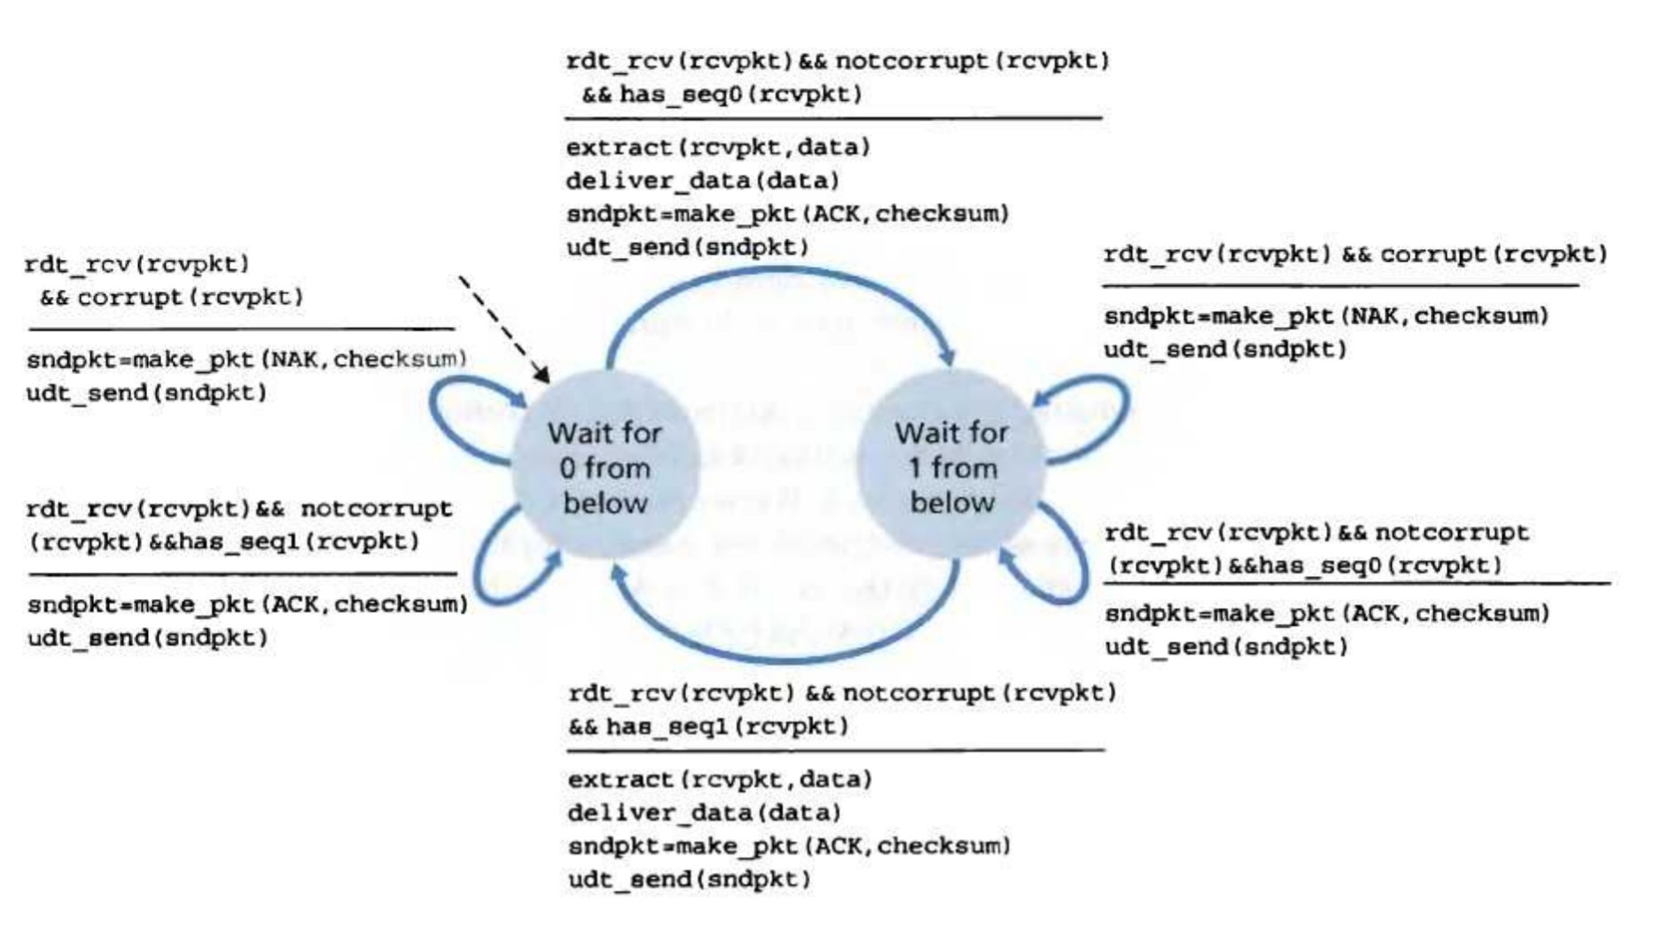
rdt2.1: receiver, handles garbled ACK/NAKs
rdt_rcv(rcvpkt) && notcorrupt(rcvpkt)
&& has_seq0(rcvpkt)
extract(rcvpkt,data)
deliver_data(data)
sndpkt = make_pkt(ACK, chksum)
udt_send(sndpkt)
rdt_rcv(rcvpkt) && (corrupt(rcvpkt)
rdt_rcv(rcvpkt) && (corrupt(rcvpkt)
sndpkt = make_pkt(NAK, chksum)
udt_send(sndpkt)
sndpkt = make_pkt(NAK, chksum)
udt_send(sndpkt)
Wait for
0 from below
Wait for
1 from below
rdt_rcv(rcvpkt) &&
not corrupt(rcvpkt) &&
has_seq1(rcvpkt)
rdt_rcv(rcvpkt) &&
not corrupt(rcvpkt) &&
has_seq0(rcvpkt)
sndpkt = make_pkt(ACK, chksum)
udt_send(sndpkt)
sndpkt = make_pkt(ACK, chksum)
udt_send(sndpkt)
rdt_rcv(rcvpkt) && notcorrupt(rcvpkt)
&& has_seq1(rcvpkt)
extract(rcvpkt,data)
deliver_data(data)
sndpkt = make_pkt(ACK, chksum)
udt_send(sndpkt)
Transport Layer
3-30

Slide 31
rdt2.1: discussion
Sender:
seq # added to pkt
two seq. #’s (0,1) will suffice. Why?
must check if received ACK/NAK corrupted
twice as many states
state must “remember” whether “current” pkt has 0 or 1 seq. #
Receiver:
must check if received packet is duplicate
state indicates whether 0 or 1 is expected pkt seq #
note: receiver can not know if its last ACK/NAK received OK at sender
Transport Layer
3-31

Slide 32
rdt2.2: a NAK-free protocol
same functionality as rdt2.1, using ACKs only
instead of NAK, receiver sends ACK for last pkt received OK
receiver must explicitly include seq # of pkt being ACKed
duplicate ACK at sender results in same action as NAK: retransmit current pkt
Transport Layer
3-32

Slide 33
rdt2.2: sender, receiver fragments
rdt_send(data)
sndpkt = make_pkt(0, data, checksum)
udt_send(sndpkt)
rdt_rcv(rcvpkt) &&
( corrupt(rcvpkt) ||
isACK(rcvpkt,1) )
Wait for call 0 from above
Wait for ACK
0
udt_send(sndpkt)
sender FSM
fragment
rdt_rcv(rcvpkt)
&& notcorrupt(rcvpkt)
&& isACK(rcvpkt,0)
rdt_rcv(rcvpkt) &&
(corrupt(rcvpkt) ||
has_seq1(rcvpkt))
receiver FSM
fragment
Λ
Wait for
0 from below
udt_send(sndpkt)
rdt_rcv(rcvpkt) && notcorrupt(rcvpkt)
&& has_seq1(rcvpkt)
extract(rcvpkt,data)
deliver_data(data)
sndpkt = make_pkt(ACK1, chksum)
udt_send(sndpkt)
Transport Layer
3-33

Slide 34
rdt3.0: channels with errors and loss
New assumption: underlying channel can also lose packets (data or ACKs)
checksum, seq. #, ACKs, retransmissions will be of help, but not enough
Approach: sender waits “reasonable” amount of time for ACK
retransmits if no ACK received in this time
if pkt (or ACK) just delayed (not lost):
retransmission will be duplicate, but use of seq. #’s already handles this
receiver must specify seq # of pkt being ACKed
requires countdown timer
Transport Layer
3-34

Slide 35
rdt3.0 sender
rdt_send(data)
rdt_rcv(rcvpkt) &&
( corrupt(rcvpkt) ||
isACK(rcvpkt,1) )
sndpkt = make_pkt(0, data, checksum)
udt_send(sndpkt)
start_timer
rdt_rcv(rcvpkt)
Λ
Λ
Wait for
call 0from above
Wait for ACK0
timeout
udt_send(sndpkt)
start_timer
rdt_rcv(rcvpkt)
&& notcorrupt(rcvpkt)
&& isACK(rcvpkt,1)
rdt_rcv(rcvpkt)
&& notcorrupt(rcvpkt)
&& isACK(rcvpkt,0)
stop_timer
stop_timer
Wait for ACK1
Wait for
call 1 from above
timeout
udt_send(sndpkt)
start_timer
rdt_rcv(rcvpkt)
rdt_send(data)
Λ
rdt_rcv(rcvpkt) &&
( corrupt(rcvpkt) ||
isACK(rcvpkt,0) )
sndpkt = make_pkt(1, data, checksum)
udt_send(sndpkt)
start_timer
Λ
Transport Layer
3-35

Slide 36
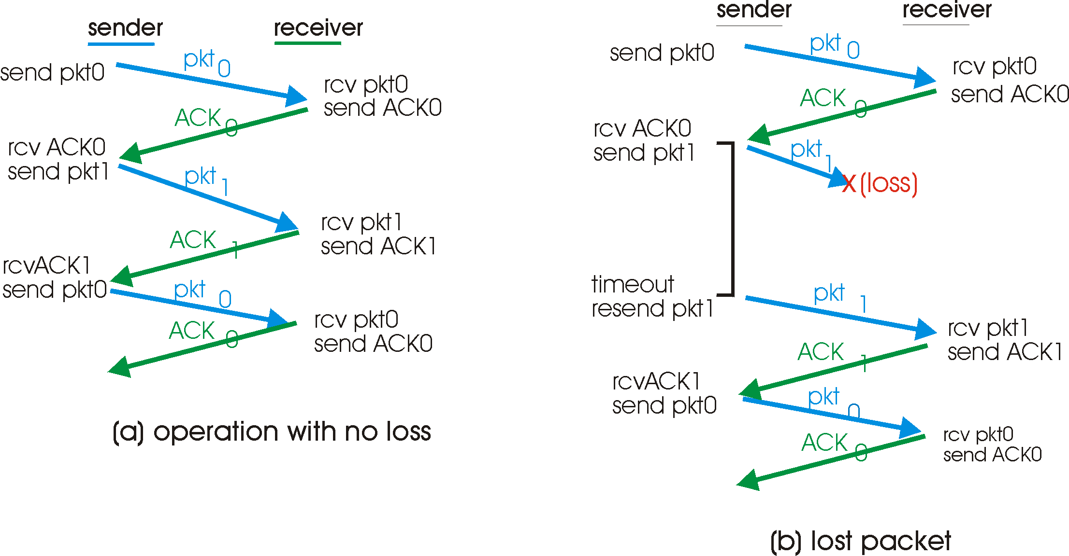
rdt3.0 in action
Transport Layer
3-36

Slide 37
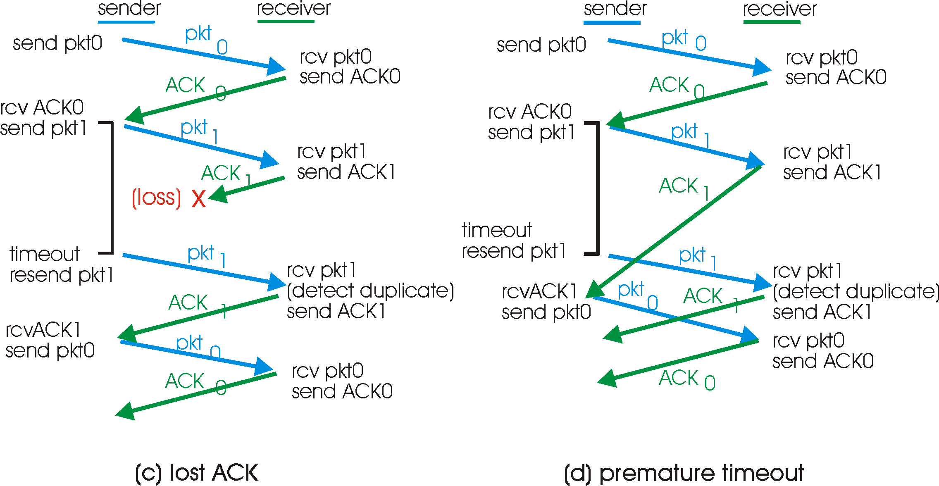
rdt3.0 in action
Transport Layer
3-37

Slide 38
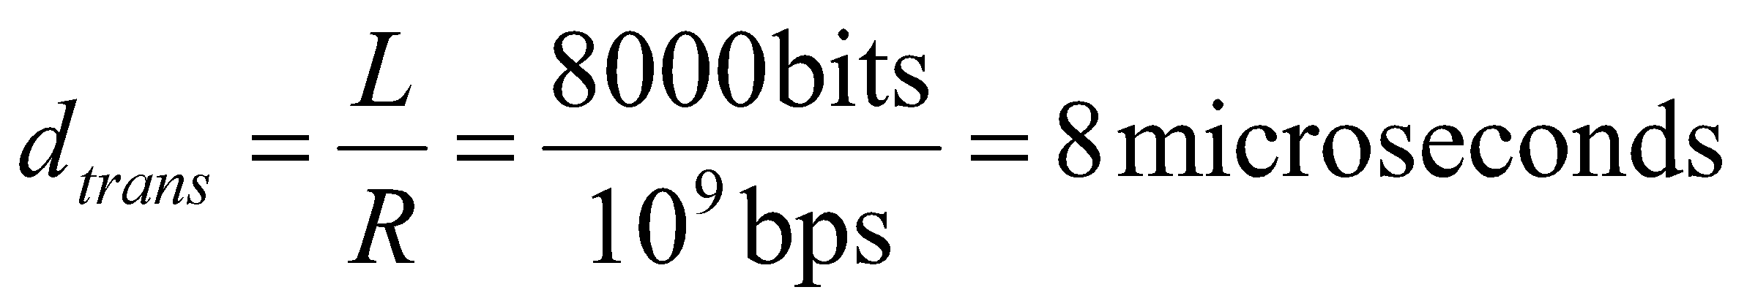
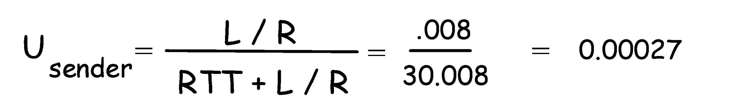
Performance of rdt3.0
rdt3.0 works, but performance stinks
ex: 1 Gbps link, 15 ms prop. delay, 8000 bit packet:
U _{sender}: utilization – fraction of time sender busy sending
1KB pkt every 30 msec -> 33kB/sec thruput over 1 Gbps link
network protocol limits use of physical resources!
Transport Layer
3-38

Slide 39
rdt3.0: stop-and-wait operation
sender
receiver
first packet bit transmitted, t = 0
last packet bit transmitted, t = L / R
first packet bit arrives
RTT
last packet bit arrives, send ACK
ACK arrives, send next
packet, t = RTT + L / R
Transport Layer
3-39

Slide 40
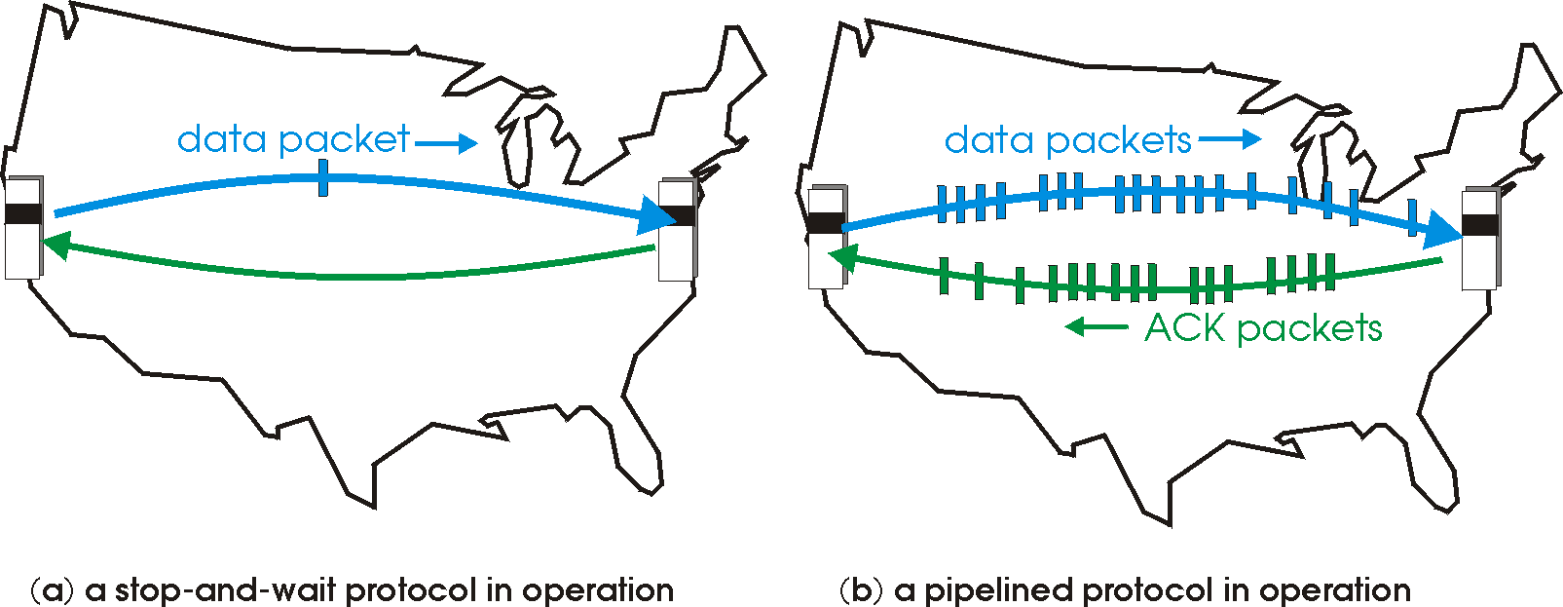
Pipelined protocols
Pipelining: sender allows multiple, “in-flight”, yet-to-be-acknowledged pkts
range of sequence numbers must be increased
buffering at sender and/or receiver
Two generic forms of pipelined protocols: go-Back-N, selective repeat
Transport Layer
3-40

Slide 41
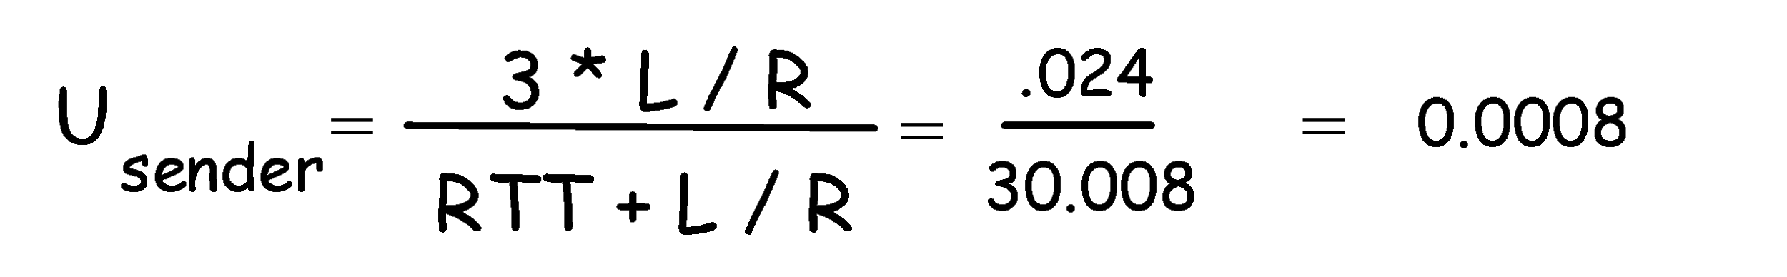
Pipelining: increased utilization
sender
receiver
first packet bit transmitted, t = 0
last bit transmitted, t = L / R
first packet bit arrives
RTT
last packet bit arrives, send ACK
last bit of 2nd packet arrives, send ACK
last bit of 3rd packet arrives, send ACK
ACK arrives, send next
packet, t = RTT + L / R
Increase utilization
by a factor of 3!
Transport Layer
3-41

Slide 42
Pipelining Protocols
Go-back-N: overview
sender: up to N unACKed pkts in pipeline
receiver: only sends cumulative ACKs
doesn’t ACK pkt if there’s a gap
sender: has timer for oldest unACKed pkt
if timer expires: retransmit all unACKed packets
Selective Repeat: overview
sender: up to N unACKed packets in pipeline
receiver: ACKs individual pkts
sender: maintains timer for each unACKed pkt
if timer expires: retransmit only unACKed packet
Transport Layer
3-42

Slide 43
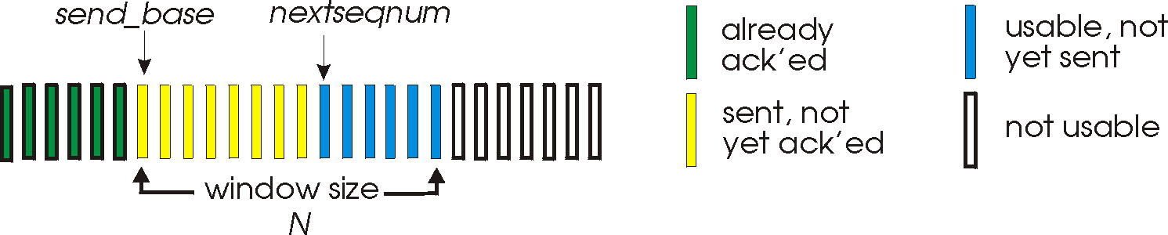
Go-Back-N
Sender:
k-bit seq # in pkt header
“window” of up to N, consecutive unACKed pkts allowed
ACK(n): ACKs all pkts up to, including seq # n - “cumulative ACK”
may receive duplicate ACKs (see receiver)
timer for each in-flight pkt
timeout(n): retransmit pkt n and all higher seq # pkts in window
Transport Layer
3-43

Slide 44
GBN: sender extended FSM
rdt_send(data)
if (nextseqnum < base+N) {
sndpkt[nextseqnum] = make_pkt(nextseqnum,data,chksum)
udt_send(sndpkt[nextseqnum])
if (base == nextseqnum)
start_timer
nextseqnum++
}
else
refuse_data(data)
Λ
base=1
nextseqnum=1
timeout
Wait
start_timer
udt_send(sndpkt[base])
udt_send(sndpkt[base+1])
…
udt_send(sndpkt[nextseqnum-1])
rdt_rcv(rcvpkt)
&& corrupt(rcvpkt)
rdt_rcv(rcvpkt) &&
notcorrupt(rcvpkt)
base = getacknum(rcvpkt)+1
If (base == nextseqnum)
stop_timer
else
start_timer
Transport Layer
3-44

Slide 45
GBN: receiver extended FSM
default
udt_send(sndpkt)
rdt_rcv(rcvpkt)
&& notcurrupt(rcvpkt)
&& hasseqnum(rcvpkt,expectedseqnum)
Λ
Wait
extract(rcvpkt,data)
deliver_data(data)
sndpkt = make_pkt(expectedseqnum,ACK,chksum)
udt_send(sndpkt)
expectedseqnum++
expectedseqnum=1
sndpkt =
make_pkt(expectedseqnum,ACK,chksum)
ACK-only: always send ACK for correctly-received pkt with highest in-order seq #
may generate duplicate ACKs
need only remember expectedseqnum
out-of-order pkt:
discard (don’t buffer) -> no receiver buffering!
Re-ACK pkt with highest in-order seq #
Transport Layer
3-45

Slide 46
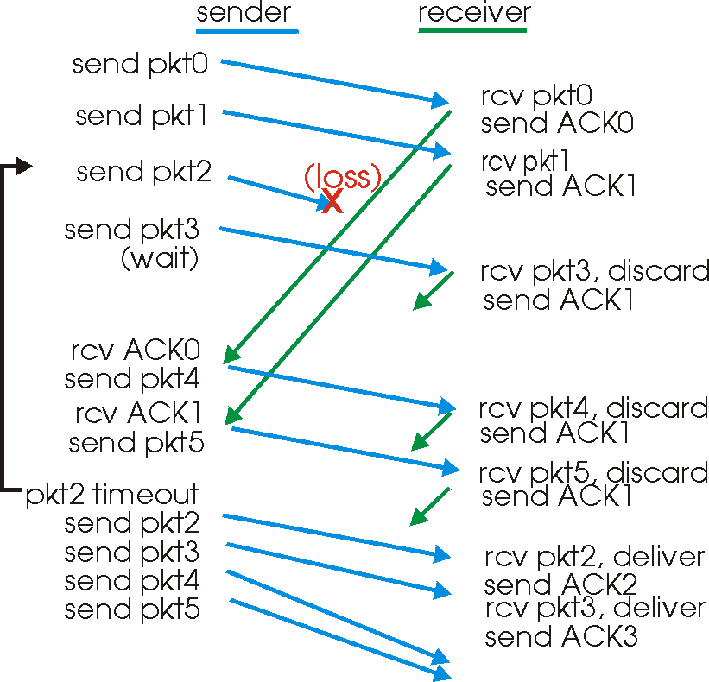
GBN in action
Transport Layer
3-46

Slide 47
Selective Repeat
receiver individually acknowledges all correctly received pkts
buffers pkts, as needed, for eventual in-order delivery to upper layer
sender only resends pkts for which ACK not received
sender timer for each unACKed pkt
sender window
N consecutive seq #’s
again limits seq #s of sent, unACKed pkts
Transport Layer
3-47

Slide 48
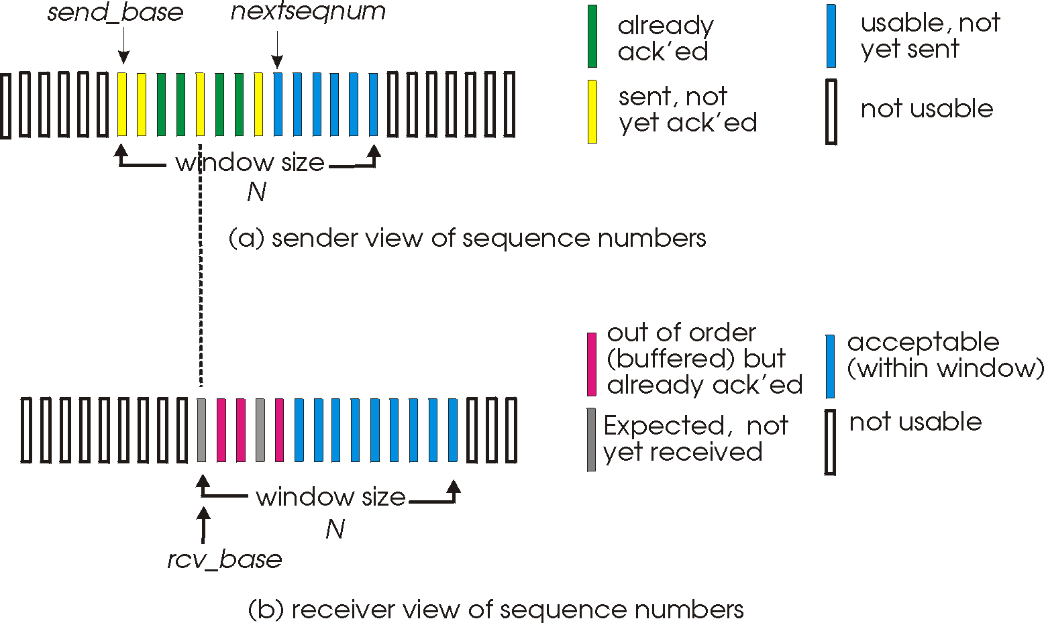
Selective repeat: sender, receiver windows
Transport Layer
3-48

Slide 49
Selective repeat
sender
receiver
data from above :
if next available seq # in window, send pkt
timeout(n):
resend pkt n, restart timer
ACK(n) in [sendbase,sendbase+N]:
mark pkt n as received
if n smallest unACKed pkt, advance window base to next unACKed seq #
pkt n in [rcvbase, rcvbase+N-1]
send ACK(n)
out-of-order: buffer
in-order: deliver (also deliver buffered, in-order pkts), advance window to next not-yet-received pkt
pkt n in [rcvbase-N,rcvbase-1]
ACK(n)
otherwise:
ignore
Transport Layer
3-49

Slide 50
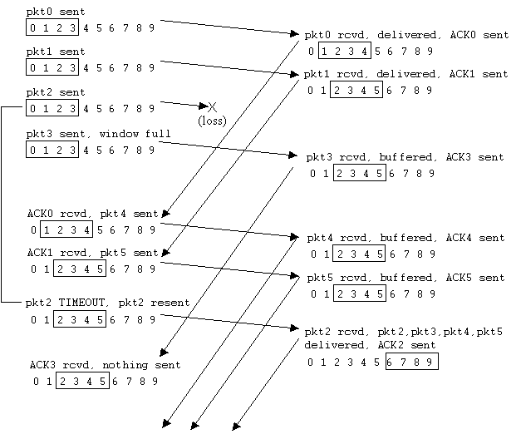
Selective repeat in action
Transport Layer
3-50

Slide 51
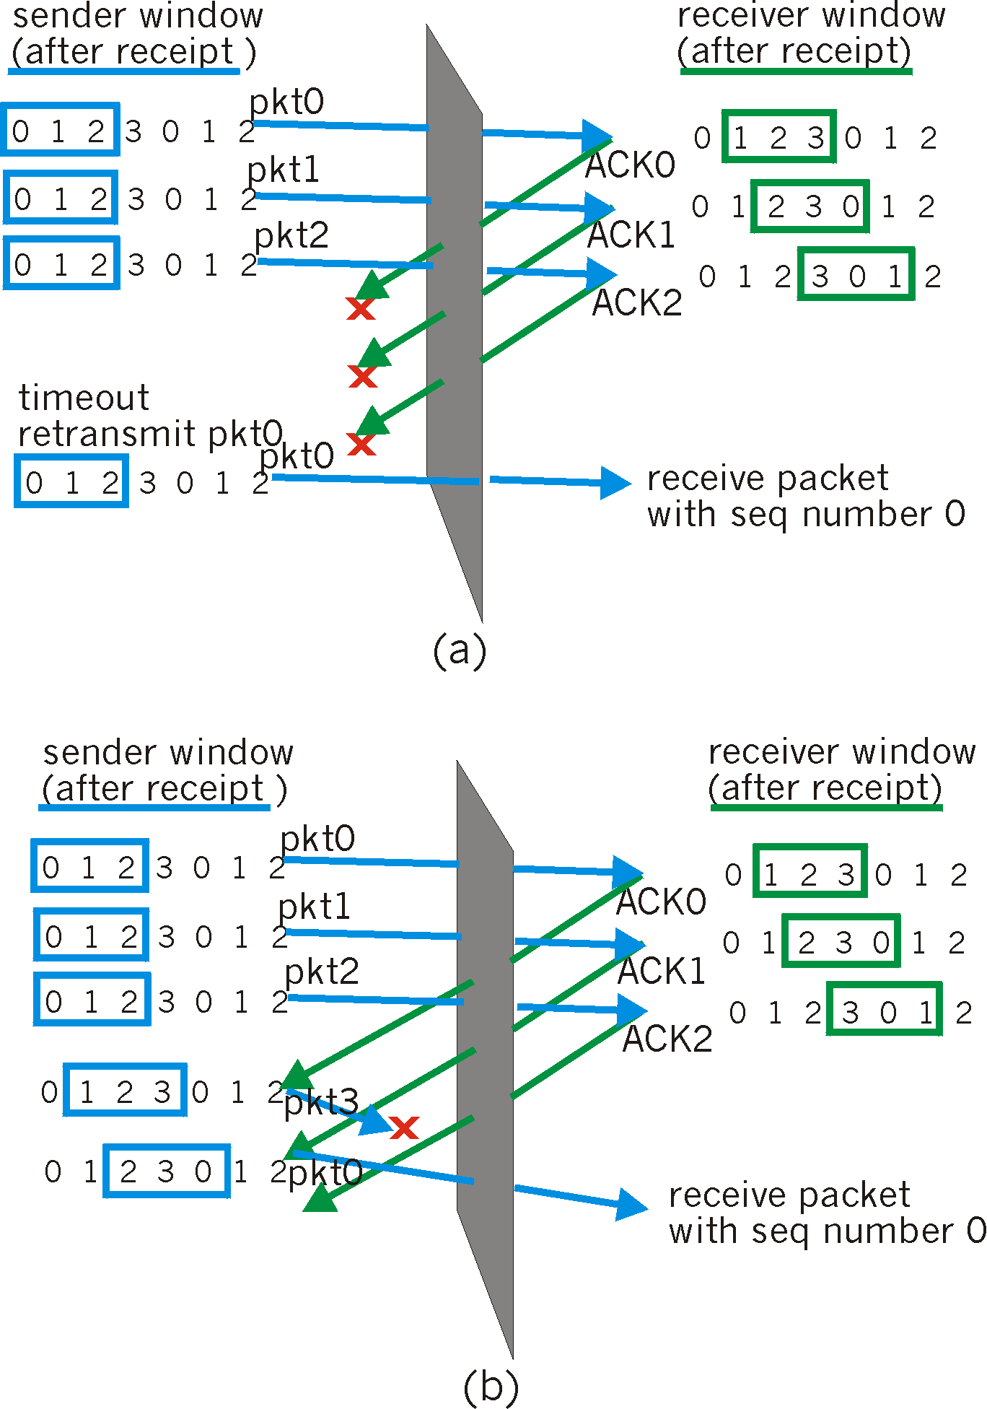
Selective repeat: dilemma
Example:
seq #’s: 0, 1, 2, 3
window size=3
receiver sees no difference in two scenarios!
incorrectly passes duplicate data as new in (a)
Q: what relationship between seq # size and window size?
Transport Layer
3-51

Slide 52
Chapter 3 outline
3.1 Transport-layer services
3.2 Multiplexing and demultiplexing
3.3 Connectionless transport: UDP
3.4 Principles of reliable data transfer
3.5 Connection-oriented transport: TCP
segment structure
reliable data transfer
flow control
connection management
3.6 Principles of congestion control
3.7 TCP congestion control
Transport Layer
3-52

Slide 53
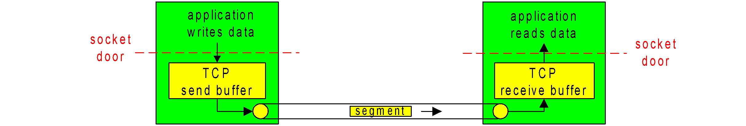
TCP: Overview RFCs: 793, 1122, 1323, 2018, 2581
point-to-point:
one sender, one receiver
reliable, in-order byte steam:
no “message boundaries”
pipelined:
TCP congestion and flow control set window size
send & receive buffers
full duplex data:
bi-directional data flow in same connection
MSS: maximum segment size
connection-oriented:
handshaking (exchange of control msgs) init’s sender, receiver state before data exchange
flow controlled:
sender will not overwhelm receiver
Transport Layer
3-53

Slide 54
TCP segment structure
32 bits
URG: urgent data
(generally not used)
counting
by bytes
of data
(not segments!)
source port #
dest port #
sequence number
ACK: ACK #
valid
acknowledgement number
head
len
not
used
U
Receive window
A
P
R
S
PSH: push data now
(generally not used)
F
# bytes
rcvr willing
to accept
checksum
Urg data pointer
RST, SYN, FIN:
connection estab
(setup, teardown
commands)
Options (variable length)
application
data
(variable length)
Internet
checksum
(as in UDP)
Transport Layer
3-54

Slide 55

TCP seq. #’s and ACKs
Seq. #’s:
byte stream “number” of first byte in segment’s data
ACKs:
seq # of next byte expected from other side
cumulative ACK
Q: how receiver handles out-of-order segments
A: TCP spec doesn’t say, - up to implementer
Host A
Host B
User
types
‘C’
Seq=42, ACK=79, data = ‘C’
host ACKs
receipt of
‘C’, echoes
back ‘C’
Seq=79, ACK=43, data = ‘C’
host ACKs
receipt
of echoed
‘C’
Seq=43, ACK=80
time
simple telnet scenario
Transport Layer
3-55

Slide 56
TCP Round Trip Time and Timeout
Q: how to set TCP timeout value?
longer than RTT
but RTT varies
too short: premature timeout
unnecessary retransmissions
too long: slow reaction to segment loss
Q: how to estimate RTT?
SampleRTT: measured time from segment transmission until ACK receipt
ignore retransmissions
SampleRTT will vary, want estimated RTT “smoother”
average several recent measurements, not just current SampleRTT
Transport Layer
3-56

Slide 57
TCP Round Trip Time and Timeout
EstimatedRTT = (1- α)*EstimatedRTT + α*SampleRTT
Exponential weighted moving average
influence of past sample decreases exponentially fast
typical value: α = 0.125
Transport Layer
3-57

Slide 58
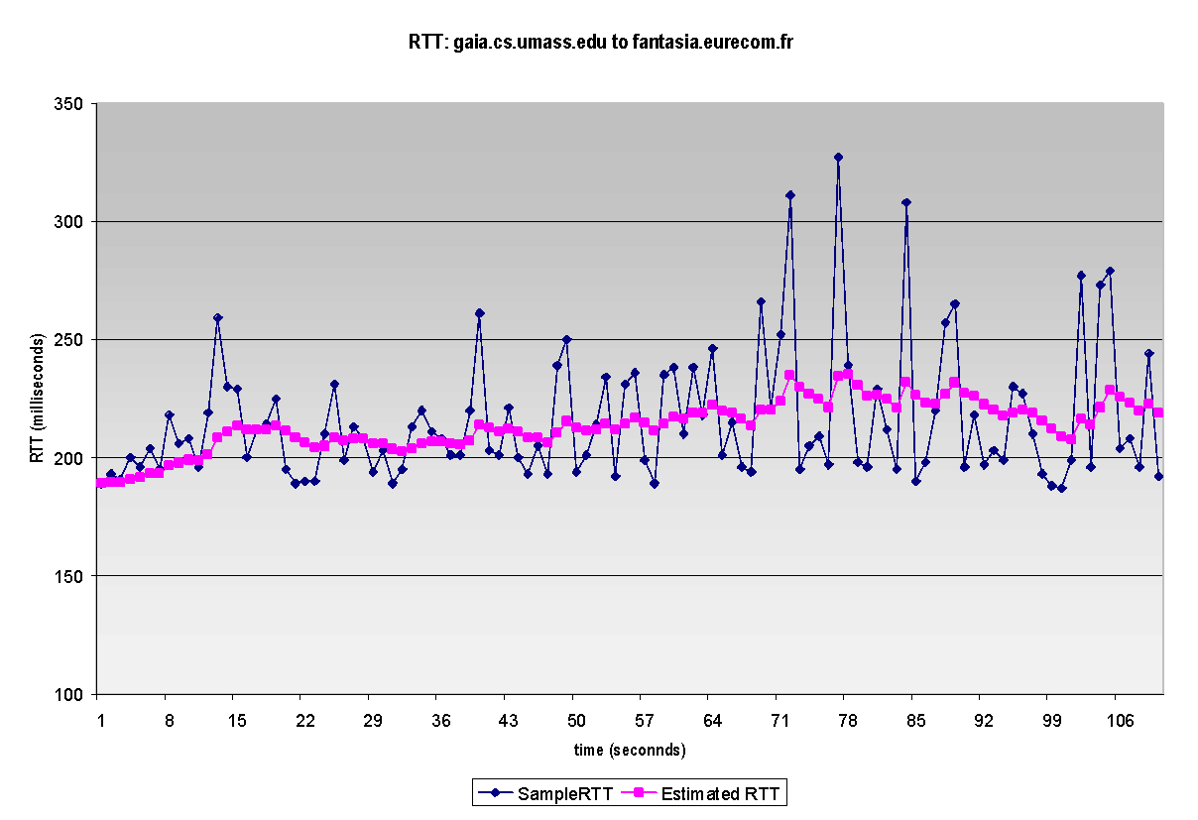
Example RTT estimation:
Transport Layer
3-58

Slide 59
TCP Round Trip Time and Timeout
Setting the timeout
EstimtedRTT plus “safety margin”
large variation in EstimatedRTT -> larger safety margin
first estimate of how much SampleRTT deviates from EstimatedRTT:
DevRTT = (1-β)*DevRTT +
β*|SampleRTT-EstimatedRTT|
(typically, β = 0.25)
Then set timeout interval:
TimeoutInterval = EstimatedRTT + 4*DevRTT
Transport Layer
3-59

Slide 60
Chapter 3 outline
3.1 Transport-layer services
3.2 Multiplexing and demultiplexing
3.3 Connectionless transport: UDP
3.4 Principles of reliable data transfer
3.5 Connection-oriented transport: TCP
segment structure
reliable data transfer
flow control
connection management
3.6 Principles of congestion control
3.7 TCP congestion control
Transport Layer
3-60

Slide 61
TCP reliable data transfer
TCP creates rdt service on top of IP’s unreliable service
pipelined segments
cumulative ACKs
TCP uses single retransmission timer
retransmissions are triggered by:
timeout events
duplicate ACKs
initially consider simplified TCP sender:
ignore duplicate ACKs
ignore flow control, congestion control
Transport Layer
3-61

Slide 62
TCP sender events:
data rcvd from app:
create segment with seq #
seq # is byte-stream number of first data byte in segment
start timer if not already running (think of timer as for oldest unACKed segment)
expiration interval: TimeOutInterval
timeout:
retransmit segment that caused timeout
restart timer
ACK rcvd:
if acknowledges previously unACKed segments
update what is known to be ACKed
start timer if there are outstanding segments
Transport Layer
3-62

Slide 63
TCP sender (simplified)
NextSeqNum = InitialSeqNum
SendBase = InitialSeqNum
loop (forever) {
switch(event)
event: data received from application above
create TCP segment with sequence number NextSeqNum
if (timer currently not running)
start timer
pass segment to IP
NextSeqNum = NextSeqNum + length(data)
event: timer timeout
retransmit not-yet-acknowledged segment with
smallest sequence number
start timer
event: ACK received, with ACK field value of y
if (y > SendBase) {
SendBase = y
if (there are currently not-yet-acknowledged segments)
start timer
}
} /* end of loop forever */
Comment:
SendBase-1: last
cumulatively ACKed byte
Example:
SendBase-1 = 71; y= 73, so the rcvr wants 73+ ; y > SendBase, so that new data is ACKed
Transport Layer
3-63

Slide 64
TCP: retransmission scenarios
Host A
Host B
Host A
Host B
Seq=92, 8 bytes data
Seq=92, 8 bytes data
Seq=100, 20 bytes data
ACK=100
Seq=92 timeout
timeout
ACK=100
X
loss
ACK=120
Seq=92, 8 bytes data
Sendbase
= 100
Seq=92, 8 bytes data
SendBase
= 120
Seq=92 timeout
ACK=120
ACK=100
SendBase
= 100
SendBase
= 120
premature timeout
time
time
lost ACK scenario
Transport Layer
3-64

Slide 65
TCP retransmission scenarios (more)
Host A
Host B
Seq=92, 8 bytes data
ACK=100
timeout
Seq=100, 20 bytes data
X
loss
SendBase
= 120
ACK=120
time
Cumulative ACK scenario
Transport Layer
3-65

Slide 66
TCP ACK generation [RFC 1122, RFC 2581]
Event at Receiver
Arrival of in-order segment with
expected seq #. All data up to
expected seq # already ACKed
Arrival of in-order segment with
expected seq #. One other
segment has ACK pending
Arrival of out-of-order segment
higher-than-expect seq. # .
Gap detected
Arrival of segment that
partially or completely fills gap
TCP Receiver action
Delayed ACK. Wait up to 500ms
for next segment. If no next segment,
send ACK
Immediately send single cumulative
ACK, ACKing both in-order segments
Immediately send duplicate ACK,
indicating seq. # of next expected byte
Immediate send ACK, provided that
segment starts at lower end of gap
Transport Layer
3-66

Slide 67
Fast Retransmit
time-out period often relatively long:
long delay before resending lost packet
detect lost segments via duplicate ACKs.
sender often sends many segments back-to-back
if segment is lost, there will likely be many duplicate ACKs for that segment
If sender receives 3 ACKs for same data, it assumes that segment after ACKed data was lost:
fast retransmit: resend segment before timer expires
Transport Layer
3-67

Slide 68
Host A
Host B
seq # x1
seq # x2
seq # x3
X
ACK x1
seq # x4
seq # x5
ACK x1
ACK x1
ACK x1
triple
duplicate
ACKs
resend seq X2
timeout
time
Transport Layer
3-68

Slide 69
Fast retransmit algorithm:
event: ACK received, with ACK field value of y
if (y > SendBase) {
SendBase = y
if (there are currently not-yet-acknowledged segments)
start timer
}
else {
increment count of dup ACKs received for y
if (count of dup ACKs received for y = 3) {
resend segment with sequence number y
}
a duplicate ACK for
already ACKed segment
fast retransmit
Transport Layer
3-69

Slide 70
Chapter 3 outline
3.1 Transport-layer services
3.2 Multiplexing and demultiplexing
3.3 Connectionless transport: UDP
3.4 Principles of reliable data transfer
3.5 Connection-oriented transport: TCP
segment structure
reliable data transfer
flow control
connection management
3.6 Principles of congestion control
3.7 TCP congestion control
Transport Layer
3-70

Slide 71
TCP Flow Control
flow control
sender won’t overflow
receiver’s buffer by
transmitting too much,
too fast
receive side of TCP connection has a receive buffer:
(currently)
unused buffer
space
speed-matching service: matching send rate to receiving application’s drain rate
IP
datagrams
TCP data
(in buffer)
application
process
app process may be slow at reading from buffer
Transport Layer
3-71

Slide 72
TCP Flow control: how it works
(currently)
unused buffer
space
receiver: advertises unused buffer space by including rwnd value in segment header
sender: limits # of unACKed bytes to rwnd
guarantees receiver’s buffer doesn’t overflow
IP
datagrams
TCP data
(in buffer)
application
process
rwnd
RcvBuffer
(suppose TCP receiver discards out-of-order segments)
unused buffer space:
= rwnd
= RcvBuffer-[LastByteRcvd - LastByteRead]
Transport Layer
3-72

Slide 73
Chapter 3 outline
3.1 Transport-layer services
3.2 Multiplexing and demultiplexing
3.3 Connectionless transport: UDP
3.4 Principles of reliable data transfer
3.5 Connection-oriented transport: TCP
segment structure
reliable data transfer
flow control
connection management
3.6 Principles of congestion control
3.7 TCP congestion control
Transport Layer
3-73

Slide 74
TCP Connection Management
Recall: TCP sender, receiver establish “connection” before exchanging data segments
initialize TCP variables:
seq. #s
buffers, flow control info (e.g. RcvWindow)
client: connection initiator
Socket clientSocket = new Socket("hostname","port number");
server: contacted by client
Socket connectionSocket = welcomeSocket.accept();
Three way handshake:
Step 1: client host sends TCP SYN segment to server
specifies initial seq #
no data
Step 2: server host receives SYN, replies with SYNACK segment
server allocates buffers
specifies server initial seq. #
Step 3: client receives SYNACK, replies with ACK segment, which may contain data
Transport Layer
3-74

Slide 75
TCP Connection Management (cont.)
Closing a connection:
client closes socket: clientSocket.close();
Step 1: client end system sends TCP FIN control segment to server
Step 2: server receives FIN, replies with ACK. Closes connection, sends FIN.
client
server
close
FIN
ACK
close
FIN
ACK
timed wait
closed
Transport Layer
3-75

Slide 76
TCP Connection Management (cont.)
Step 3: client receives FIN, replies with ACK.
Enters “timed wait” - will respond with ACK to received FINs
Step 4: server, receives ACK. Connection closed.
Note: with small modification, can handle simultaneous FINs.
client
server
closing
FIN
ACK
closing
FIN
ACK
timed wait
closed
closed
Transport Layer
3-76

Slide 77
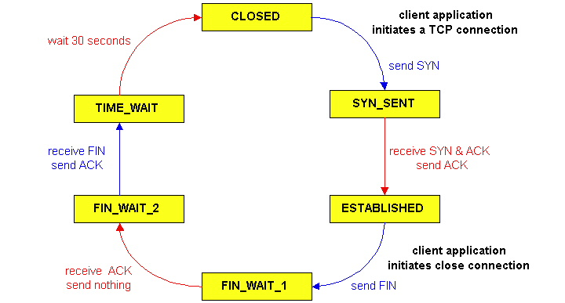
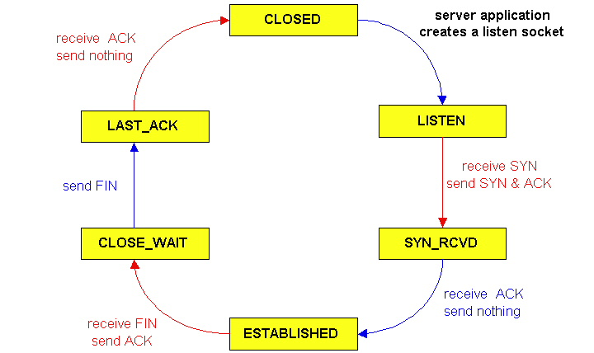
TCP Connection Management (cont)
TCP server
lifecycle
TCP client
lifecycle
Transport Layer
3-77

Slide 78
Chapter 3 outline
3.1 Transport-layer services
3.2 Multiplexing and demultiplexing
3.3 Connectionless transport: UDP
3.4 Principles of reliable data transfer
3.5 Connection-oriented transport: TCP
segment structure
reliable data transfer
flow control
connection management
3.6 Principles of congestion control
3.7 TCP congestion control
Transport Layer
3-78

Slide 79
Principles of Congestion Control
Congestion:
informally: “too many sources sending too much data too fast for network to handle”
different from flow control!
manifestations:
lost packets (buffer overflow at routers)
long delays (queueing in router buffers)
a top-10 problem!
Transport Layer
3-79

Slide 80
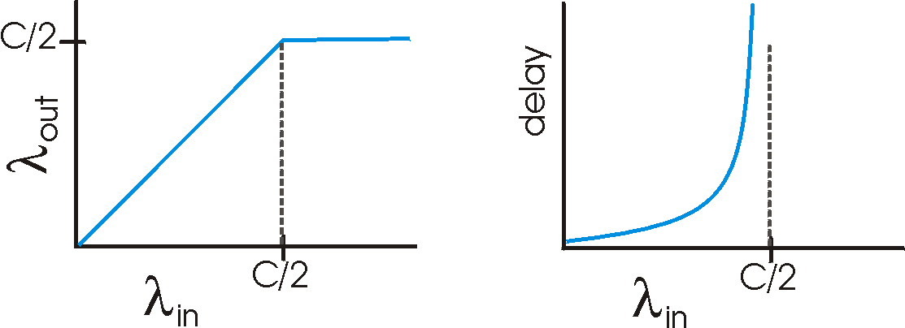
Causes/costs of congestion: scenario 1
two senders, two receivers
one router, infinite buffers
no retransmission
Host A
λ_{in} : original data
λ_{out}
Host B
unlimited shared output link buffers
large delays when congested
maximum achievable throughput
Transport Layer
3-80

Slide 81
Causes/costs of congestion: scenario 2
one router, finite buffers
sender retransmission of lost packet
Host A
λ_{in} : original data
λ_{out}
λ'_{in} : original data, plus retransmitted data
Host B
finite shared output link buffers
Transport Layer
3-81

Slide 82
Causes/costs of congestion: scenario 2
λ
λ
always: (goodput)
“perfect” retransmission only when loss:
retransmission of delayed (not lost) packet makes larger (than perfect case) for same
=
in
out
λ
>
λ
in
out
λ
in
λ
out
R/2
R/2
R/2
R/3
λ_{out}
λ_{out}
λ_{out}
R/4
λ_{in}
R/2
λ_{in}
R/2
λ_{in}
R/2
a.
b.
c.
“costs” of congestion:
more work (retrans) for given “goodput”
unneeded retransmissions: link carries multiple copies of pkt
Transport Layer
3-82

Slide 83
Causes/costs of congestion: scenario 3
λ
four senders
multihop paths
timeout/retransmit
Q: what happens as and increase ?
λ
in
in
Host A
λ_{in} : original data
λ_{out}
λ'_{in} : original data, plus retransmitted data
finite shared output link buffers
Host B
Transport Layer
3-83

Slide 84
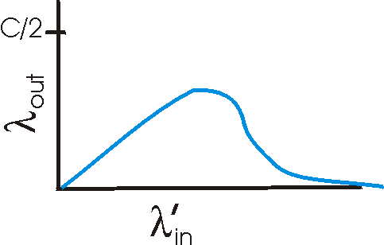
Causes/costs of congestion: scenario 3
Host A
λ_{out}
Host B
another “cost” of congestion:
when packet dropped, any “upstream transmission capacity used for that packet was wasted!
Transport Layer
3-84

Slide 85
Approaches towards congestion control
two broad approaches towards congestion control:
end-end congestion control:
no explicit feedback from network
congestion inferred from end-system observed loss, delay
approach taken by TCP
network-assisted congestion control:
routers provide feedback to end systems
single bit indicating congestion (SNA, DECbit, TCP/IP ECN, ATM)
explicit rate sender should send at
Transport Layer
3-85

Slide 86
Case study: ATM ABR congestion control
ABR: available bit rate:
“elastic service”
if sender’s path “underloaded”:
sender should use available bandwidth
if sender’s path congested:
sender throttled to minimum guaranteed rate
RM (resource management) cells:
sent by sender, interspersed with data cells
bits in RM cell set by switches (“network-assisted”)
NI bit: no increase in rate (mild congestion)
CI bit: congestion indication
RM cells returned to sender by receiver, with bits intact
Transport Layer
3-86

Slide 87
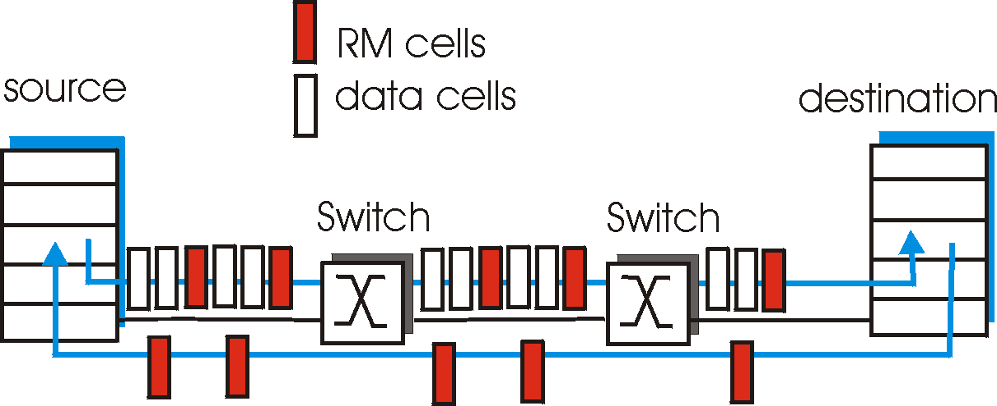
Case study: ATM ABR congestion control
two-byte ER (explicit rate) field in RM cell
congested switch may lower ER value in cell
sender’ send rate thus maximum supportable rate on path
EFCI bit in data cells: set to 1 in congested switch
if data cell preceding RM cell has EFCI set, sender sets CI bit in returned RM cell
Transport Layer
3-87

Slide 88
Chapter 3 outline
3.1 Transport-layer services
3.2 Multiplexing and demultiplexing
3.3 Connectionless transport: UDP
3.4 Principles of reliable data transfer
3.5 Connection-oriented transport: TCP
segment structure
reliable data transfer
flow control
connection management
3.6 Principles of congestion control
3.7 TCP congestion control
Transport Layer
3-88

Slide 89
TCP congestion control:
goal: TCP sender should transmit as fast as possible, but without congesting network
Q: how to find rate just below congestion level
decentralized: each TCP sender sets its own rate, based on implicit feedback:
ACK: segment received (a good thing!), network not congested, so increase sending rate
lost segment: assume loss due to congested network, so decrease sending rate
Transport Layer
3-89

Slide 90
TCP congestion control: bandwidth probing
“probing for bandwidth”: increase transmission rate on receipt of ACK, until eventually loss occurs, then decrease transmission rate
continue to increase on ACK, decrease on loss (since available bandwidth is changing, depending on other connections in network)
ACKs being received,
so increase rate
X
loss, so decrease rate
X
X
X
TCP’s
“sawtooth”
behavior
sending rate
X
time
Q: how fast to increase/decrease?
details to follow
Transport Layer
3-90

Slide 91
TCP Congestion Control: details
sender limits rate by limiting number of unACKed bytes “in pipeline”:
cwnd: differs from rwnd (how, why?)
sender limited by min(cwnd,rwnd)
roughly,
cwnd is dynamic, function of perceived network congestion
LastByteSent-LastByteAcked ≤ cwnd
cwnd
bytes
cwnd
rate =
bytes/sec
RTT
RTT
ACK(s)
Transport Layer
3-91

Slide 92
TCP Congestion Control: more details
segment loss event: reducing cwnd
timeout: no response from receiver
cut cwnd to 1
3 duplicate ACKs: at least some segments getting through (recall fast retransmit)
cut cwnd in half, less aggressively than on timeout
ACK received: increase cwnd
slowstart phase:
increase exponentially fast (despite name) at connection start, or following timeout
congestion avoidance:
increase linearly
Transport Layer
3-92

Slide 93
TCP Slow Start
when connection begins, cwnd = 1 MSS
example: MSS = 500 bytes & RTT = 200 msec
initial rate = 20 kbps
available bandwidth may be >> MSS/RTT
desirable to quickly ramp up to respectable rate
increase rate exponentially until first loss event or when threshold reached
double cwnd every RTT
done by incrementing cwnd by 1 for every ACK received
Host A
Host B
one segment
RTT
two segments
four segments
time
Transport Layer
3-93

Slide 94
Transitioning into/out of slowstart
ssthresh: cwnd threshold maintained by TCP
on loss event: set ssthresh to cwnd/2
remember (half of) TCP rate when congestion last occurred
when cwnd >= ssthresh: transition from slowstart to congestion avoidance phase
duplicate ACK
dupACKcount++
new ACK
cwnd = cwnd+MSS
dupACKcount = 0
transmit new segment(s),as allowed
Λ
cwnd = 1 MSS
ssthresh = 64 KB
dupACKcount = 0
cwnd > ssthresh
slow
start
Λ
congestion
avoidance
timeout
ssthresh = cwnd/2
cwnd = 1 MSS
dupACKcount = 0
retransmit missing segment
timeout
ssthresh = cwnd/2
cwnd = 1 MSS
dupACKcount = 0
retransmit missing segment
Transport Layer
3-94

Slide 95
TCP: congestion avoidance
when cwnd > ssthresh grow cwnd linearly
increase cwnd by 1 MSS per RTT
approach possible congestion slower than in slowstart
implementation: cwnd = cwnd + MSS/cwnd for each ACK received
AIMD
ACKs: increase cwnd by 1 MSS per RTT: additive increase
loss: cut cwnd in half (non-timeout-detected loss ): multiplicative decrease
AIMD: Additive Increase
Multiplicative Decrease
Transport Layer
3-95

Slide 96

TCP congestion control FSM: overview
slow
start
cwnd > ssthresh
congestion
avoidance
loss:
timeout
loss:
timeout
loss:
timeout
new ACK
loss:
3dupACK
fast
recovery
loss:
3dupACK
Transport Layer
3-96

Slide 97
TCP congestion control FSM: details
.
duplicate ACK
new ACK
dupACKcount++
new ACK
cwnd = cwnd + MSS (MSS/cwnd)
dupACKcount = 0
transmit new segment(s),as allowed
cwnd = cwnd+MSS
dupACKcount = 0
transmit new segment(s),as allowed
Λ
cwnd = 1 MSS
ssthresh = 64 KB
dupACKcount = 0
cwnd > ssthresh
slow
start
Λ
congestion
avoidance
timeout
ssthresh = cwnd/2
cwnd = 1 MSS
dupACKcount = 0
retransmit missing segment
duplicate ACK
timeout
dupACKcount++
ssthresh = cwnd/2
cwnd = 1 MSS
dupACKcount = 0
retransmit missing segment
timeout
ssthresh = cwnd/2
cwnd = 1
dupACKcount = 0
retransmit missing segment
New ACK
dupACKcount == 3
cwnd = ssthresh
dupACKcount = 0
dupACKcount == 3
ssthresh= cwnd/2
cwnd = ssthresh + 3
retransmit missing segment
ssthresh= cwnd/2
cwnd = ssthresh + 3
retransmit missing segment
fast
recovery
duplicate ACK
cwnd = cwnd + MSS
transmit new segment(s), as allowed
Transport Layer
3-97

Slide 98
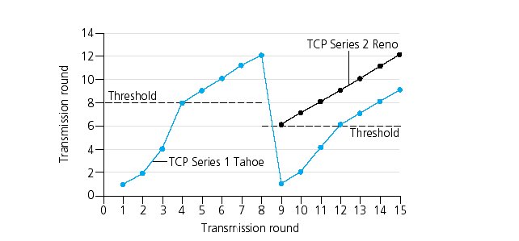
Popular “flavors” of TCP
TCP Reno
ssthresh
cwnd window size (in segments)
ssthresh
TCP Tahoe
Transmission round
Transport Layer
3-98

Slide 99
Summary: TCP Congestion Control
when cwnd < ssthresh, sender in slow-start phase, window grows exponentially.
when cwnd >= ssthresh, sender is in congestion-avoidance phase, window grows linearly.
when triple duplicate ACK occurs, ssthresh set to cwnd/2, cwnd set to ~ ssthresh
when timeout occurs, ssthresh set to cwnd/2, cwnd set to 1 MSS.
Transport Layer
3-99

Slide 100
TCP throughput
Q: what’s average throughout of TCP as function of window size, RTT?
ignoring slow start
let W be window size when loss occurs.
when window is W, throughput is W/RTT
just after loss, window drops to W/2, throughput to W/2RTT.
average throughout: .75 W/RTT
Transport Layer
3-100

Slide 101
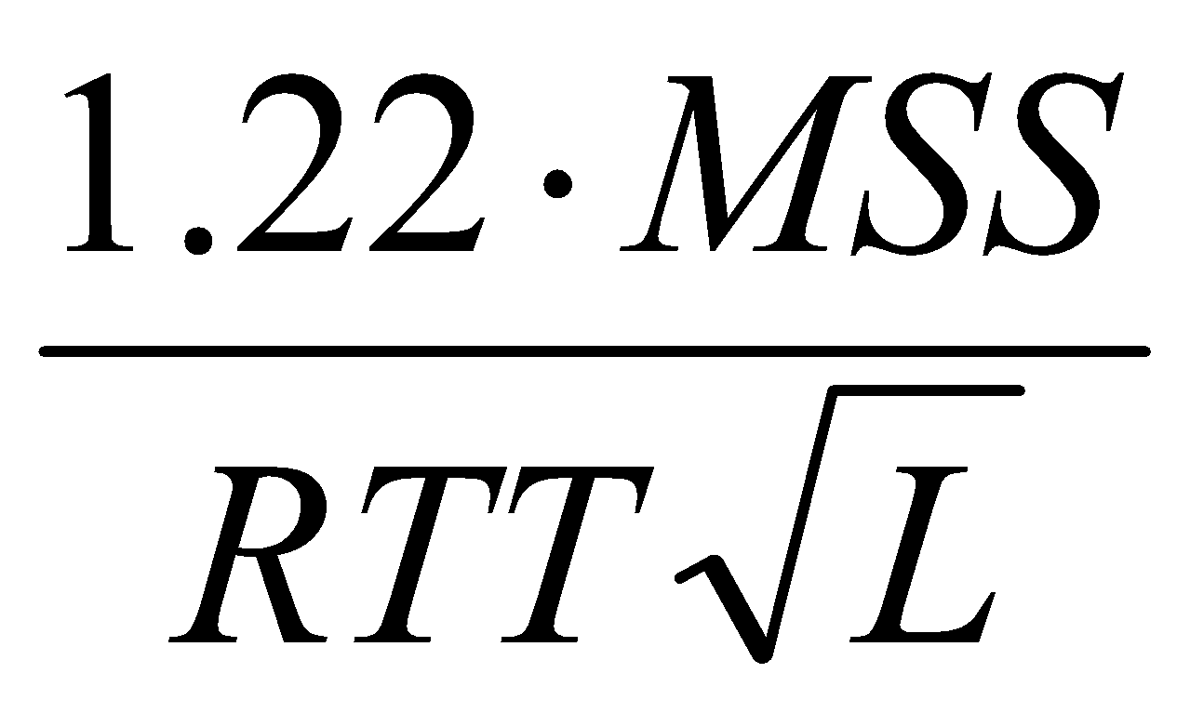
TCP Futures: TCP over “long, fat pipes”
example: 1500 byte segments, 100ms RTT, want 10 Gbps throughput
requires window size W = 83,333 in-flight segments
throughput in terms of loss rate:
➜ L = 2·10⁻¹⁰ Wow
new versions of TCP for high-speed
Transport Layer
3-101

Slide 102

TCP Fairness
fairness goal: if K TCP sessions share same bottleneck link of bandwidth R, each should have average rate of R/K
TCP connection 1
TCP
connection 2
bottleneck
router
capacity R
Transport Layer
3-102

Slide 103
Why is TCP fair?
Two competing sessions:
Additive increase gives slope of 1, as throughout increases
multiplicative decrease decreases throughput proportionally
R
equal bandwidth share
loss: decrease window by factor of 2
congestion avoidance: additive increase
Connection 2 throughput
loss: decrease window by factor of 2
congestion avoidance: additive increase
Connection 1 throughput
R
Transport Layer
3-103

Slide 104
Fairness (more)
Fairness and UDP
multimedia apps often do not use TCP
do not want rate throttled by congestion control
instead use UDP:
pump audio/video at constant rate, tolerate packet loss
Fairness and parallel TCP connections
nothing prevents app from opening parallel connections between 2 hosts.
web browsers do this
example: link of rate R supporting 9 connections;
new app asks for 1 TCP, gets rate R/10
new app asks for 11 TCPs, gets R/2 !
Transport Layer
3-104

Slide 105
Chapter 3: Summary
principles behind transport layer services:
multiplexing, demultiplexing
reliable data transfer
flow control
congestion control
instantiation and implementation in the Internet
UDP
TCP
Next:
leaving the network “edge” (application, transport layers)
into the network “core”
Transport Layer
3-105

Slide 106
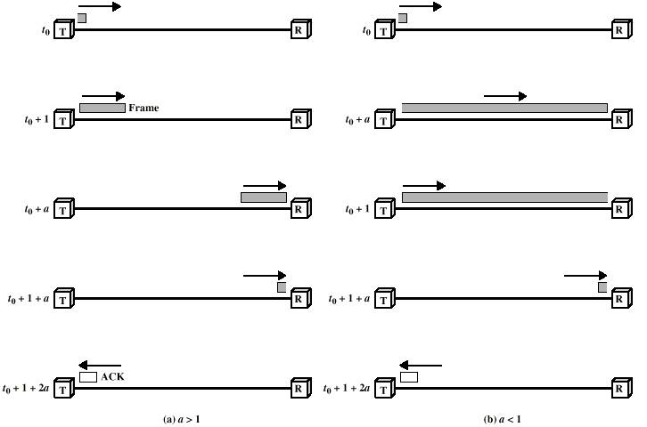
Stop and Wait Link Utilization

Slide 107
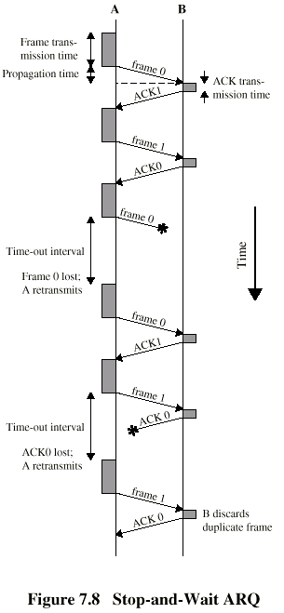
Stop and Wait - Diagram

Slide 108
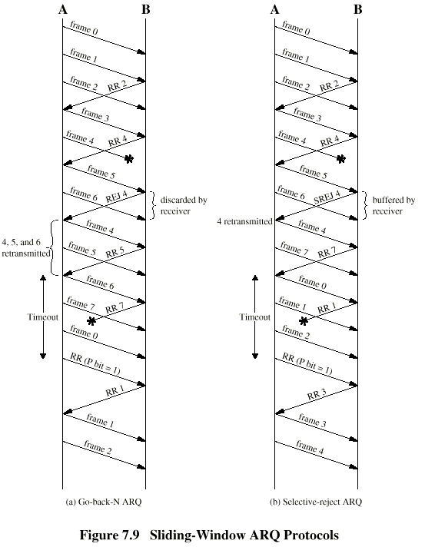
Go Back N - Diagram

Slide 109
Selective Reject - Diagram

